Slide 1
CHAPTER 5
UNSUPERVISED LEARNING NETWORKS
“Principles of Soft Computing, 2nd Edition”
by S.N. Sivanandam & SN Deepa
Copyright © 2011 Wiley India Pvt. Ltd. All rights reserved.

Slide 2
UNSUPERVISED LEARNING
No help from the outside.
No training data, no information available on the desired output.
Learning by doing.
Used to pick out structure in the input:
    Clustering,
    Reduction of dimensionality → compression.
Example: Kohonen’s Learning Law.
“Principles of Soft Computing, 2nd Edition”
by S.N. Sivanandam & SN Deepa
Copyright © 2011 Wiley India Pvt. Ltd. All rights reserved.

Slide 3
FEW UNSUPERVISED LEARNING NETWORKS
There exists several networks under this category, such as
Max Net,
Mexican Hat,
Kohonen Self-organizing Feature Maps,
Learning Vector Quantization,
Counterpropagation Networks,
Hamming Network,
Adaptive Resonance Theory.
“Principles of Soft Computing, 2nd Edition”
by S.N. Sivanandam & SN Deepa
Copyright © 2011 Wiley India Pvt. Ltd. All rights reserved.

Slide 4
COMPETITIVE LEARNING
Output units compete, so that eventually only one neuron (the one with the most input) is active in response to each output pattern.
The total weight from the input layer to each output neuron is limited. If some connections are strengthened, others must be weakened.
A consequence is that the winner is the output neuron whose weights best match the activation pattern.
“Principles of Soft Computing, 2nd Edition”
by S.N. Sivanandam & SN Deepa
Copyright © 2011 Wiley India Pvt. Ltd. All rights reserved.

Slide 5
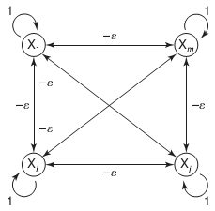
MAX NET
Max Net is a fixed weight competitive net.
Max Net serves as a subnet for picking the node whose input is larger. All the nodes present in this subnet are fully interconnected and there exist symmetrical weights in all these weighted interconnections.
The weights between the neurons are inhibitory and fixed.
The architecture of this net is as shown:
“Principles of Soft Computing, 2nd Edition”
by S.N. Sivanandam & SN Deepa
Copyright © 2011 Wiley India Pvt. Ltd. All rights reserved.

Slide 6
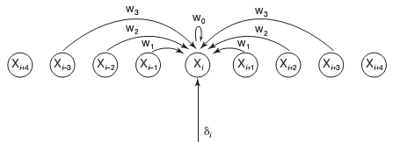
MEXICAN HAT NETWORK
Kohonen developed the Mexican hat network which is a more generalized contrast enhancement network compared to the earlier Max Net.
Here, in addition to the connections within a particular layer of neural net, the neurons also receive some other external signals. This interconnection pattern is repeated for several other neurons in the layer.
The architecture for the network is as shown below:
“Principles of Soft Computing, 2nd Edition”
by S.N. Sivanandam & SN Deepa
Copyright © 2011 Wiley India Pvt. Ltd. All rights reserved.

Slide 7
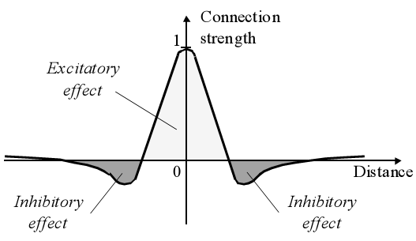
MEXICAN HAT FUNCTION OF LATERAL CONNECTION
“Principles of Soft Computing, 2nd Edition”
by S.N. Sivanandam & SN Deepa
Copyright © 2011 Wiley India Pvt. Ltd. All rights reserved.

Slide 8
MEXICAN HAT NETWORK
The lateral connections are used to create a competition between neurons. The neuron with the largest activation level among all neurons in the output layer becomes the winner. This neuron is the only neuron that produces an output signal. The activity of all other neurons is suppressed in the competition.
The lateral feedback connections produce excitatory or inhibitory effects, depending on the distance from the winning neuron. This is achieved by the use of a Mexican Hat function which describes synaptic weights between neurons in the output layer.
“Principles of Soft Computing, 2nd Edition”
by S.N. Sivanandam & SN Deepa
Copyright © 2011 Wiley India Pvt. Ltd. All rights reserved.

Slide 9
HAMMING NETWORK
The Hamming network selects stored classes, which are at a maximum Hamming distance (H) from the noisy vector presented at the input.
The Hamming distance between the two vectors is the number of components in which the vectors differ.
The Hamming network consists of two layers.
    The first layer computes the difference between the total number of components and Hamming distance between the input vector x and the stored pattern of vectors in the feed forward path.
    The second layer of the Hamming network is composed of Max Net (used as a subnet) or a winner-take-all network which is a recurrent network.
“Principles of Soft Computing, 2nd Edition”
by S.N. Sivanandam & SN Deepa
Copyright © 2011 Wiley India Pvt. Ltd. All rights reserved.

Slide 10
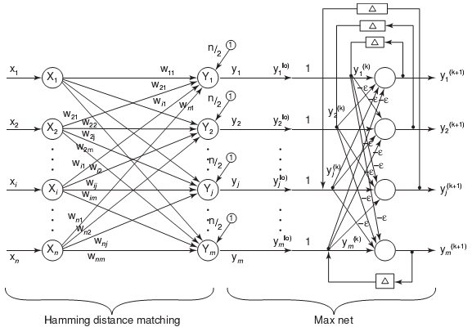
ARCHITECTURE OF HAMMING NET
“Principles of Soft Computing, 2nd Edition”
by S.N. Sivanandam & SN Deepa
Copyright © 2011 Wiley India Pvt. Ltd. All rights reserved.

Slide 11
SELF-ORGANIZATION
Network Organization is fundamental to the brain
    Functional structure.
    Layered structure.
    Both parallel processing and serial processing require organization of the brain.
“Principles of Soft Computing, 2nd Edition”
by S.N. Sivanandam & SN Deepa
Copyright © 2011 Wiley India Pvt. Ltd. All rights reserved.

Slide 12
SELF-ORGANIZING FEATURE MAP
Our brain is dominated by the cerebral cortex, a very complex structure of billions of neurons and hundreds of billions of synapses. The cortex includes areas that are responsible for different human activities (motor, visual, auditory, etc.) and associated with different sensory inputs. One can say that each sensory input is mapped into a corresponding area of the cerebral cortex. The cortex is a self-organizing computational map in the human brain.
“Principles of Soft Computing, 2nd Edition”
by S.N. Sivanandam & SN Deepa
Copyright © 2011 Wiley India Pvt. Ltd. All rights reserved.

Slide 13
SELF-ORGANIZING NETWORKS
Discover significant patterns or features in the input data.
Discovery is done without a teacher.
Synaptic weights are changed according to local rules.
The changes affect a neuron’s immediate environment until a final configuration develops.
“Principles of Soft Computing, 2nd Edition”
by S.N. Sivanandam & SN Deepa
Copyright © 2011 Wiley India Pvt. Ltd. All rights reserved.

Slide 14
KOHONEN SELF-ORGANIZING FEATURE MAP (KSOFM)
The Kohonen model provides a topological mapping.
It places a fixed number of input patterns from the input layer into a higher dimensional output or Kohonen layer.
Training in the Kohonen network begins with the winner’s neighborhood of a fairly large size. Then, as training proceeds, the neighborhood size gradually decreases.
Kohonen SOMs result from the synergy of three basic processes
        Competition,
        Cooperation,
        Adaptation.
“Principles of Soft Computing, 2nd Edition”
by S.N. Sivanandam & SN Deepa
Copyright © 2011 Wiley India Pvt. Ltd. All rights reserved.

Slide 15
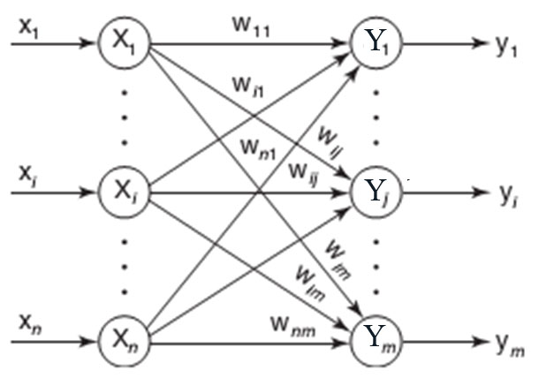
ARCHITECTURE OF KSOFM
“Principles of Soft Computing, 2nd Edition”
by S.N. Sivanandam & SN Deepa
Copyright © 2011 Wiley India Pvt. Ltd. All rights reserved.

Slide 16
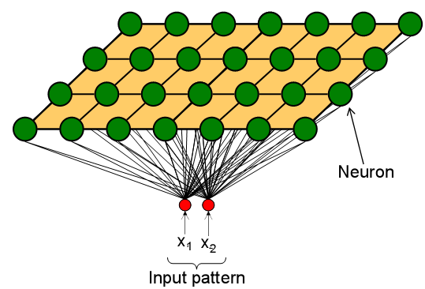
COMPETITION OF KSOFM
Each neuron in an SOM is assigned a weight vector with the same dimensionality N as the input space.
Any given input pattern is compared to the weight vector of each neuron and the closest neuron is declared the winner.
The Euclidean norm is commonly used to measure distance.
“Principles of Soft Computing, 2nd Edition”
by S.N. Sivanandam & SN Deepa
Copyright © 2011 Wiley India Pvt. Ltd. All rights reserved.

Slide 17
CO-OPERATION OF KSOFM
The activation of the winning neuron is spread to neurons in its immediate neighborhood.
This allows topologically close neurons to become sensitive to similar patterns.
The winner’s neighborhood is determined on the lattice topology.
  Distance in the lattice is a function of the number of lateral connections to the winner.
The size of the neighborhood is initially large, but shrinks over time.
  An initially large neighborhood promotes a topology-preserving mapping.
  Smaller neighborhoods allow neurons to specialize in the latter stages of training.
“Principles of Soft Computing, 2nd Edition”
by S.N. Sivanandam & SN Deepa
Copyright © 2011 Wiley India Pvt. Ltd. All rights reserved.

Slide 18
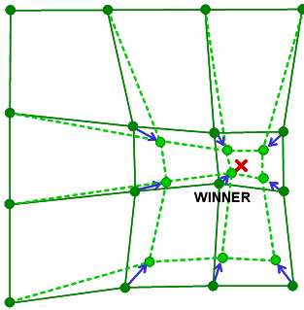
ADAPTATION OF KSOFM
During training, the winner neuron and its topological neighbors are adapted to make their weight vectors more similar to the input pattern that caused the activation.
Neurons that are closer to the winner will adapt more heavily than neurons that are further away.
The magnitude of the adaptation is controlled with a learning rate, which decays over time to ensure convergence of the SOM.
“Principles of Soft Computing, 2nd Edition”
by S.N. Sivanandam & SN Deepa
Copyright © 2011 Wiley India Pvt. Ltd. All rights reserved.

Slide 19
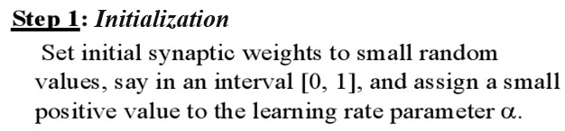
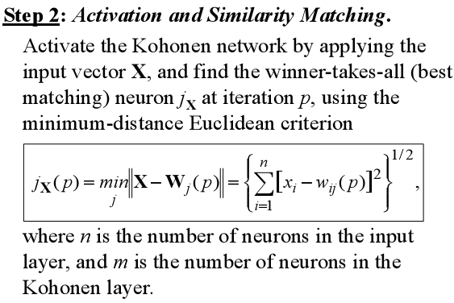
KSOFM ALGORITHM
“Principles of Soft Computing, 2nd Edition”
by S.N. Sivanandam & SN Deepa
Copyright © 2011 Wiley India Pvt. Ltd. All rights reserved.

Slide 20
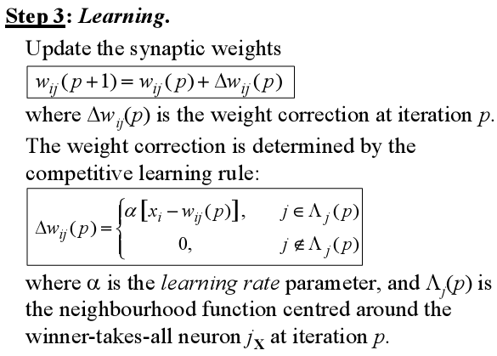
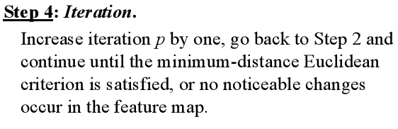
“Principles of Soft Computing, 2nd Edition”
by S.N. Sivanandam & SN Deepa
Copyright © 2011 Wiley India Pvt. Ltd. All rights reserved.

Slide 21
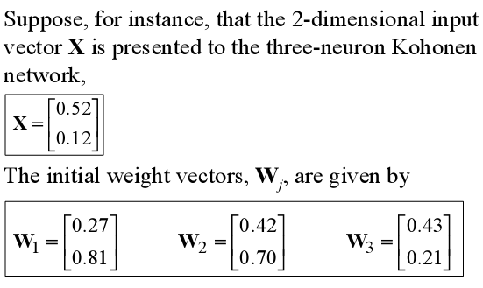
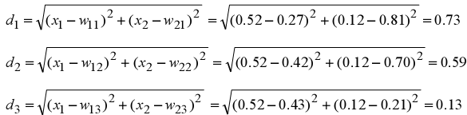
EXAMPLE OF KSOFM
Find the winning neuron using the Euclidean distance:
“Principles of Soft Computing, 2nd Edition”
by S.N. Sivanandam & SN Deepa
Copyright © 2011 Wiley India Pvt. Ltd. All rights reserved.

Slide 22


Neuron 3 is the winner and its weight vector W₃ is updated according to the competitive learning rule:
The updated weight vector W3 at iteration (p+1) is determined as:
The weight vector W3 of the winning neuron 3 becomes closer to the input vector X with each iteration.
“Principles of Soft Computing, 2nd Edition”
by S.N. Sivanandam & SN Deepa
Copyright © 2011 Wiley India Pvt. Ltd. All rights reserved.

Slide 23
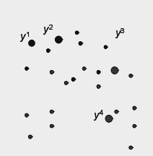
LEARNING VECTOR QUANTIZATION (LVQ)
This is a supervised version of vector quantization. Classes are predefined and we have a set of labeled data.
The goal is to determine a set of prototypes that best represent each class.
“Principles of Soft Computing, 2nd Edition”
by S.N. Sivanandam & SN Deepa
Copyright © 2011 Wiley India Pvt. Ltd. All rights reserved.

Slide 24
BASIC SCHEME OF LVQ
Step 1: Initialize prototype vectors for different classes.
Step 2: Present a single input.
Step 3: Identify the closest prototype, i.e., the so-called winner.
Step 4: Move the winner
closer toward the data (same class),
away from the data (different class).
VARIANTS OF LVQ
LVQ 1
LVQ 2
LVQ 2.1
LVQ 3
“Principles of Soft Computing, 2nd Edition”
by S.N. Sivanandam & SN Deepa
Copyright © 2011 Wiley India Pvt. Ltd. All rights reserved.

Slide 25
COUNTERPROPAGATION NETWORK
Another variant of the BPN is the counterpropagation network (CPN).
Although this network uses linear neurons, it can learn nonlinear functions by means of a hidden layer of competitive units.
Moreover, the network is able to learn a function and its inverse at the same time.
“Principles of Soft Computing, 2nd Edition”
by S.N. Sivanandam & SN Deepa
Copyright © 2011 Wiley India Pvt. Ltd. All rights reserved.

Slide 26
TYPES OF COUNTERPROPAGATION NETWORK
FULL COUNTERPROPAGATION NET
Full counterpropagation net (full CPN) efficiently represents a large number of vector pairs x:y by adaptively constructing a look-up-table.
FORWARD-ONLY COUNTERPROPAGATION NET
A simplified version of full CPN is the forward-only CPN. The approximation of the function y = f(x) but not of x = f(y) can be performed using forward-only CPN.
In forward-only CPN only the x-vectors are used to form the clusters on the Kohonen units.
“Principles of Soft Computing, 2nd Edition”
by S.N. Sivanandam & SN Deepa
Copyright © 2011 Wiley India Pvt. Ltd. All rights reserved.

Slide 27
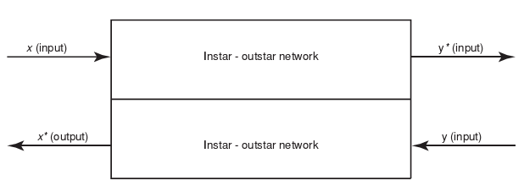
BASIC STRUCTURE OF FULL CPN
“Principles of Soft Computing, 2nd Edition”
by S.N. Sivanandam & SN Deepa
Copyright © 2011 Wiley India Pvt. Ltd. All rights reserved.

Slide 28
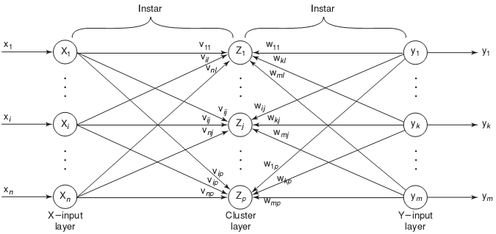
FIRST PHASE OF CPN
“Principles of Soft Computing, 2nd Edition”
by S.N. Sivanandam & SN Deepa
Copyright © 2011 Wiley India Pvt. Ltd. All rights reserved.

Slide 29
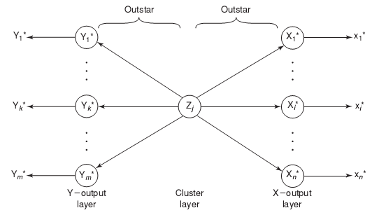
SECOND PHASE OF CPN
“Principles of Soft Computing, 2nd Edition”
by S.N. Sivanandam & SN Deepa
Copyright © 2011 Wiley India Pvt. Ltd. All rights reserved.

Slide 30
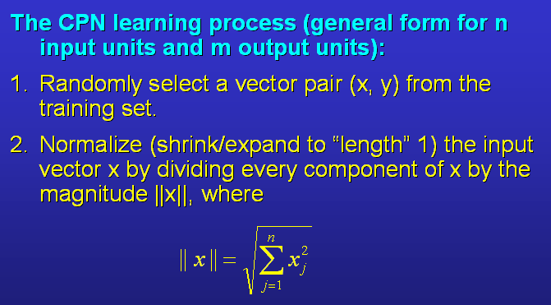
CPN LEARNING PROCESS
“Principles of Soft Computing, 2nd Edition”
by S.N. Sivanandam & SN Deepa
Copyright © 2011 Wiley India Pvt. Ltd. All rights reserved.

Slide 31
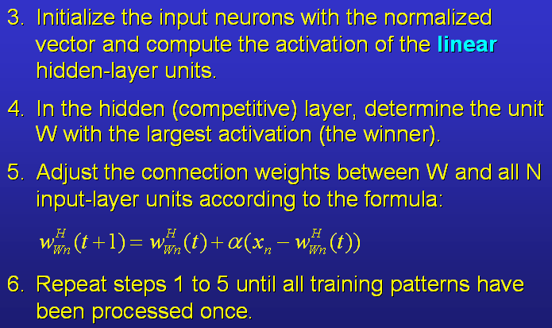
“Principles of Soft Computing, 2nd Edition”
by S.N. Sivanandam & SN Deepa
Copyright © 2011 Wiley India Pvt. Ltd. All rights reserved.

Slide 32
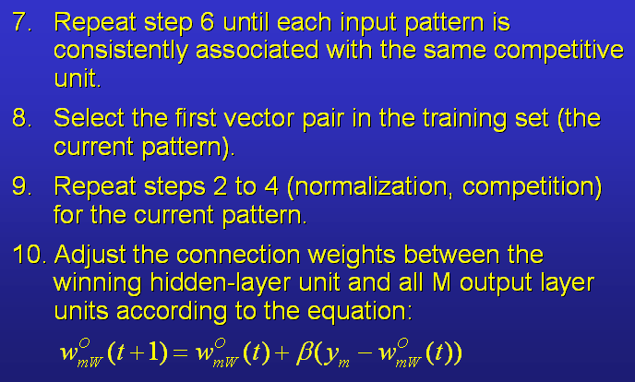
“Principles of Soft Computing, 2nd Edition”
by S.N. Sivanandam & SN Deepa
Copyright © 2011 Wiley India Pvt. Ltd. All rights reserved.

Slide 33
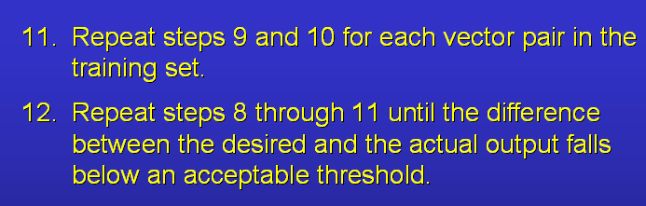
“Principles of Soft Computing, 2nd Edition”
by S.N. Sivanandam & SN Deepa
Copyright © 2011 Wiley India Pvt. Ltd. All rights reserved.

Slide 34
COUNTERPROPAGATION NETWORK
After the first phase of the training, each hidden-layer neuron is associated with a subset of input vectors.
The training process minimized the average angle difference between the weight vectors and their associated input vectors.
In the second phase of the training, we adjust the weights in the network’s output layer in such a way that, for any winning hidden-layer unit, the network’s output is as close as possible to the desired output for the winning unit’s associated input vectors.
The idea is that when we later use the network to compute functions, the output of the winning hidden-layer unit is 1 and the output of all other hidden-layer units is 0.
“Principles of Soft Computing, 2nd Edition”
by S.N. Sivanandam & SN Deepa
Copyright © 2011 Wiley India Pvt. Ltd. All rights reserved.

Slide 35
In the first training phase, if a hidden-layer unit does not win for a long period of time, its weights should be set to random values to give that unit a chance to win subsequently.
There is no need for normalizing the training output vectors.
After the training has finished, the network maps the training vectors onto output vectors that are close to the desired ones. The more hidden units, the better the mapping.
CPN can be widely used in data compression and image compression applications.
“Principles of Soft Computing, 2nd Edition”
by S.N. Sivanandam & SN Deepa
Copyright © 2011 Wiley India Pvt. Ltd. All rights reserved.

Slide 36
ADAPTIVE RESONANCE THEORY (ART) NETWORK
Adaptive Resonance Theory (ART) is a family of algorithms for unsupervised learning developed by Carpenter and Grossberg.
ART is similar to many iterative clustering algorithms where each pattern is processed by
  finding the "nearest" cluster (a.k.a. prototype or template) to that exemplar (desired).
  updating that cluster to be "closer" to the exemplar.
“Principles of Soft Computing, 2nd Edition”
by S.N. Sivanandam & SN Deepa
Copyright © 2011 Wiley India Pvt. Ltd. All rights reserved.

Slide 37
ARCHITECTURES OF ART NETWORK
ART1, designed for binary features.
ART2, designed for continuous (analog) features.
ARTMAP, a supervised version of ART.
“Principles of Soft Computing, 2nd Edition”
by S.N. Sivanandam & SN Deepa
Copyright © 2011 Wiley India Pvt. Ltd. All rights reserved.

Slide 38
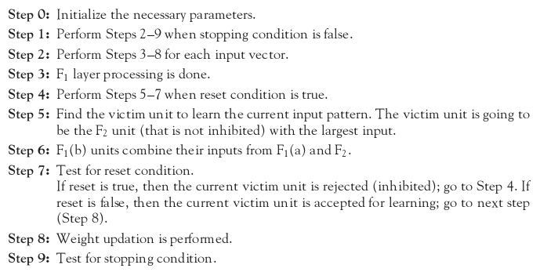
FUNDAMENTAL ALGORITHM OF ART NETWORK
“Principles of Soft Computing, 2nd Edition”
by S.N. Sivanandam & SN Deepa
Copyright © 2011 Wiley India Pvt. Ltd. All rights reserved.

Slide 39
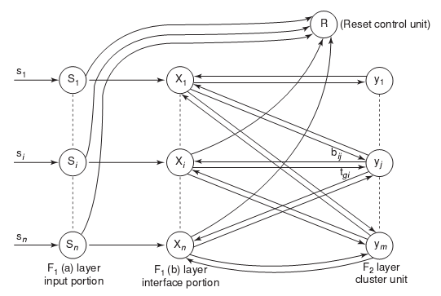
BASIC ARCHITECTURE OF ART1
“Principles of Soft Computing, 2nd Edition”
by S.N. Sivanandam & SN Deepa
Copyright © 2011 Wiley India Pvt. Ltd. All rights reserved.

Slide 40
ART1 UNITS
ART1 Network is made up of two units
Computational units
    Input unit (F1 unit – input and interface).
    Cluster unit (F2 unit – output).
    Reset control unit (controls degree of similarity).
Supplemental units
    One reset control unit.
    Two gain control units.
“Principles of Soft Computing, 2nd Edition”
by S.N. Sivanandam & SN Deepa
Copyright © 2011 Wiley India Pvt. Ltd. All rights reserved.

Slide 41
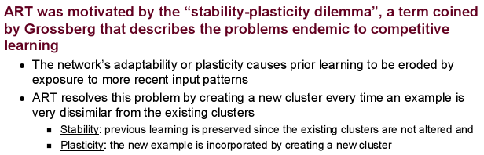
ART2 NETWORK
“Principles of Soft Computing, 2nd Edition”
by S.N. Sivanandam & SN Deepa
Copyright © 2011 Wiley India Pvt. Ltd. All rights reserved.

Slide 42
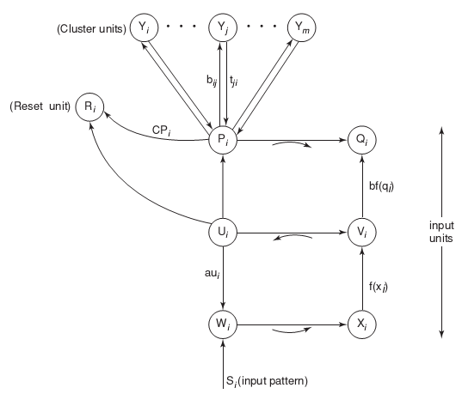
BASIC ARCHITECTURE OF ART2
“Principles of Soft Computing, 2nd Edition”
by S.N. Sivanandam & SN Deepa
Copyright © 2011 Wiley India Pvt. Ltd. All rights reserved.

Slide 43
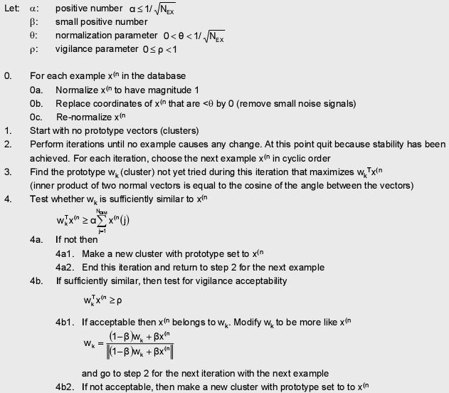
ART2 ALGORITHM
“Principles of Soft Computing, 2nd Edition”
by S.N. Sivanandam & SN Deepa
Copyright © 2011 Wiley India Pvt. Ltd. All rights reserved.

Slide 44
SUMMARY
This chapter discussed on the various unsupervised learning networks like:
Max Net
Mexican Hat
Kohonen Self-organizing Feature Maps
Learning Vector Quantization
Counterpropagation Networks
Hamming Network
Adaptive Resonance Theory
“Principles of Soft Computing, 2nd Edition”
by S.N. Sivanandam & SN Deepa
Copyright © 2011 Wiley India Pvt. Ltd. All rights reserved.

